Slide 1
Principles and Common Language of Federated Analysis
From Centralised Analytics to Privacy-Preserving Distributed Learning

Slide 2
The problem
Health data are valuable but distributed across hospitals, countries, and organisations.
Centralising individual-level data is often difficult because of:
privacy and confidentiality requirements
legal and institutional restrictions
data ownership and governance concerns
incompatible data systems and local data standards
the risk that a single dataset does not represent all populations
As a result, many studies rely on small, local datasets and may produce findings that are difficult to generalise.
Federated analytics allows organisations to analyse combined evidence while individual-level data remain within the organisations that hold them.

Slide 3
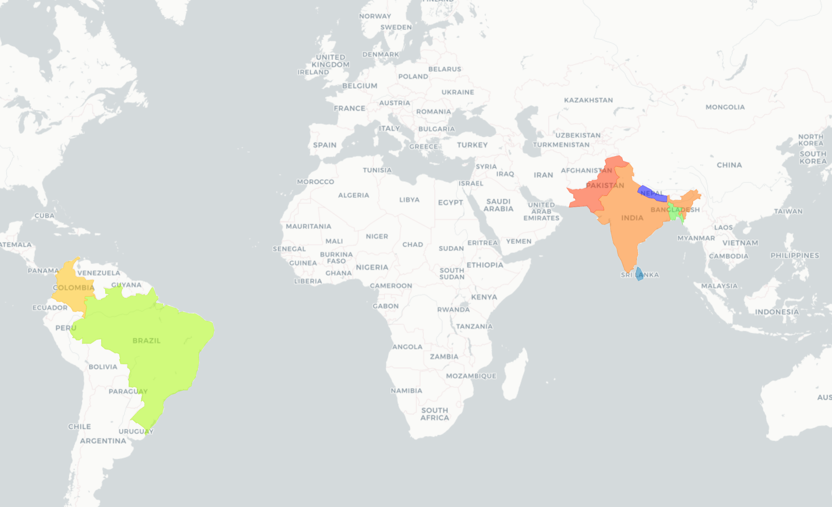

Federated Learning
A distributed machine learning paradigm
Models are trained locally where data reside: keeps its individual level data locally
runs an agreed analysis or model locally
Only model updates are shared
A global model is aggregated from local contributions
DB1
DB2
DB3
DB4
Local model 1
Local model 2
Local model 3
Local model 4
Model updates
Model Aggregation

Slide 4
Key Federated Learning Concepts
Horizontal Federated Learning
Same variables, different patients.
Sites train locally on aligned datasets and share model updates to build a stronger global model, without moving patient-level data.
Similar set of variables
Population1
Population2
Population3
Population4
DB1
DB2
DB3
DB4
Local model 1
Local model 2
Local model 3
Local model 4
Model updates
Model Aggregation

Slide 5
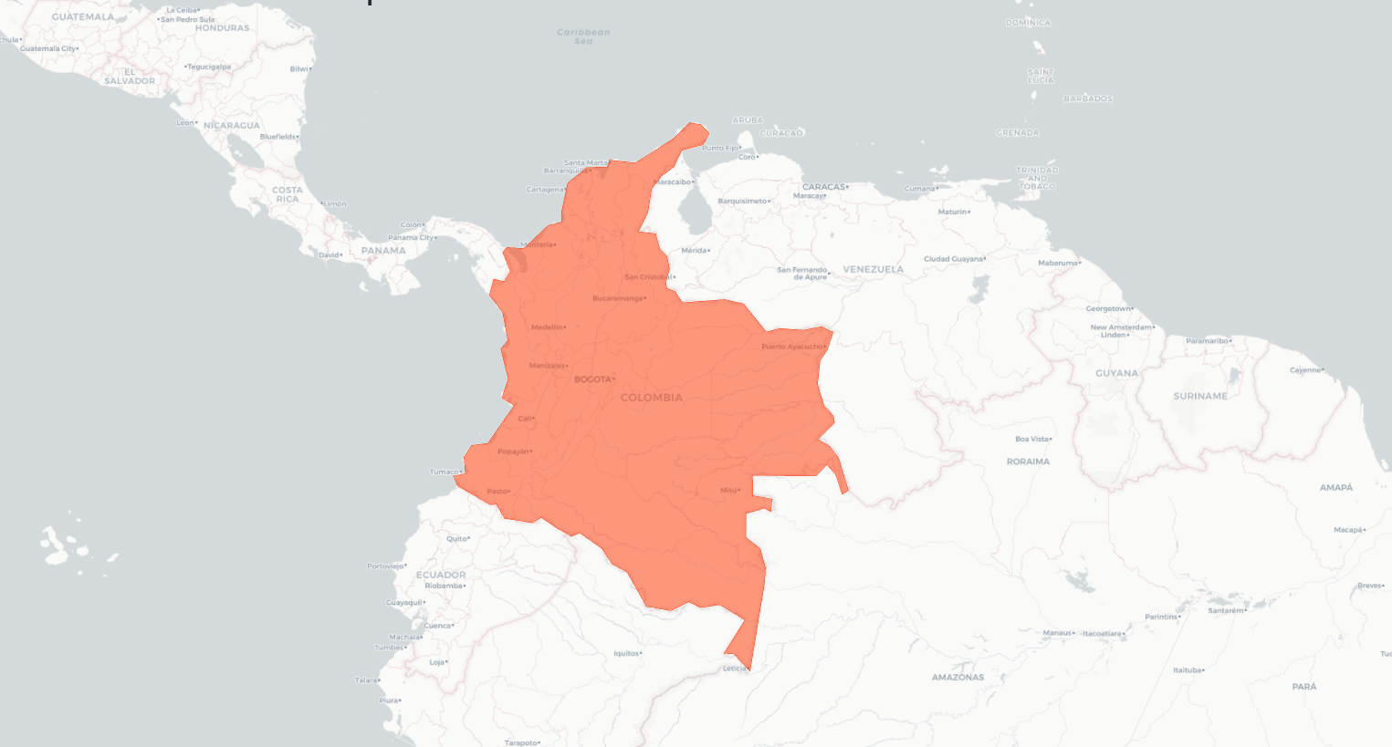
Key Federated Learning Concepts
Vertical federated learning
Combines complementary data from different sources (e.g. imaging, labs, EHR) for the same patients. By learning across distinct feature spaces, it enables richer, more holistic models without centralising data.
EHR / CRF (care delivery)
Laboratory Info System
Environment/ Contextual Exposures
DB1
DB2
DB3
Local model 1
Local model 2
Local model 3
Model updates
Model Aggregation

Slide 6
Key Federated Learning Concepts
Federated transfer learning
Allows knowledge learned in one setting (e.g. a large hospital) to be transferred and adapted to another (e.g. a smaller clinic), enabling learning even when data availability or quality differs across sites.
Similar set of variables
DB1
Source model
DB4
Local model 1
Local model 4
Model updates
Model Aggregation

